Slide 1
Object Relational Mapping
ORM
Lunch and Learn

Slide 2
What is an ORM
Main purpose is to map objects in object-oriented programming back to a relational database.
  Maps rows or records to an object automatically
  Tracks Identity
  Tracks Changes
  Manages Relationships
  Handles transactions for the database
ORMs handle all CRUD operations. Create, Read, Update, and Delete.
Data Model is the in-memory description of the actual database.
Ultimately, it becomes a translation of the database in an application or library that a user uses.

Slide 3
Where did ORM’s come from?
Edgar Frank “Ted” Codd. Credited for producing the theoretical basis of relational databases and database management systems.
There are a bunch of different ORM’s out there now.
TopLink and Oracle. JPQL
Which one do we use?
  Entity Framework 3.5 – Entity Framework Core 9

Slide 4
Why use an ORM
Wins
Losses
Maintainability
Portability
Separation of Responsibility
Simplification of Queries
Bad Queries
Sometimes a black box
Performance Issues
Security

Slide 5
Should you use an ORM for everything?
No, you shouldn’t. Ultimately it comes down to your products needs and goals. There’s a lot of heated discussion around what data access should look like in a program. Sometimes ORM’s can be used like a crutch, and the flip side is losing the mobility that they offer.

Slide 6
Best example of where to use an ORM.
Most If Not All Business Applications
  In business applications there are often the same CRUD patterns and ORMs handle these very well.
  They also handle this style of application well because there’s immediate change tracking and transactional behavior built-in.
  Rapid development and testable structures are built-in.
  Handles real world data effectively through tight or specific queries for the user.
  Good for very simple reporting to a specific control on the screen (with moderation).
A lot of business Web Sites
  Although maybe you won’t see Entity Framework used. We do see ORMs used in enterprise level websites all the time.

Slide 7
Probably bad places to use an ORM.
Bulk Data Operations
  We are talking hundreds of millions of records all need to have a series of functions ran on them here.
  They track way too much just for some nightly operation. It’s a nuke for when a fly swatter would have handled it.
Software as a Service applications
  If handled improperly it could get expensive quick with Cloud Computing bills and web applications if handled improperly.
Complex Analytical Data Processing
  You can get some very complicated queries built with LINQ but, it can take a performance nosedive quickly after the expression builder does it’s stuff.
Critical systems with sensitive data
  If you’re working at government organization or if a person's life is on the line something that can never fail is the only option.
  We aren’t going to use EF Core 9 to access logistical data for an F22 or something wild like that.

Slide 8
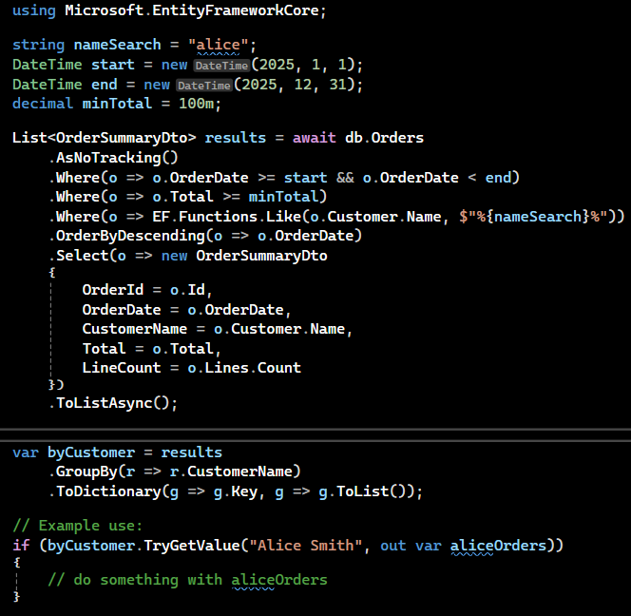
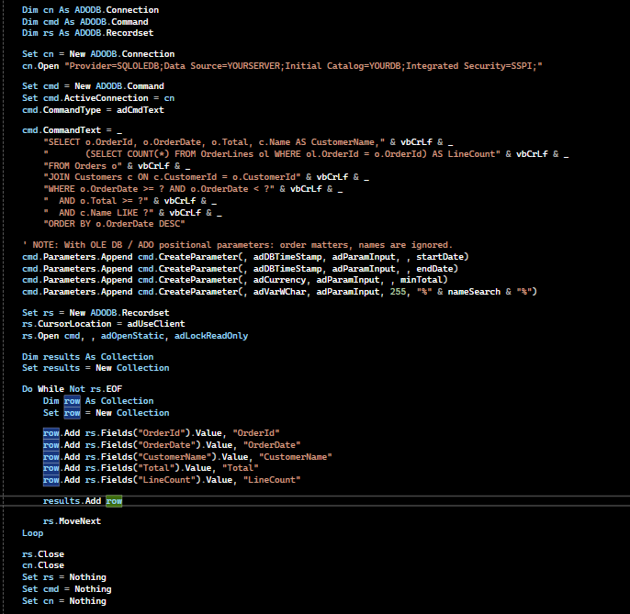
Code Comparison (Asked Claude for this)
EF Core 9 with LINQ and collections
VB6 with ADODB and RecordSets

